Slide 1
“Hello world” of deep learning

Slide 2
Practice of Deep Learning
Previous machine learning developers
Carefully design your algorithm
Theoretically know its performance
Deep learning
Try first
Many results contradict our intuition
Find some reasons to explain what we observed
More like chemistry
I would like to train a network in front of you.

Slide 3
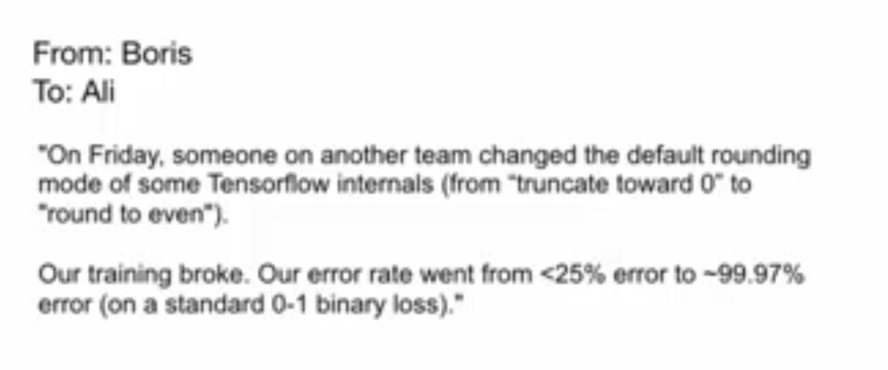
Ali Rahimi, Test of Time Award, NIPS 2017

Slide 4



Keras
If you want to learn theano:
http://speech.ee.ntu.edu.tw/~tlkagk/courses/MLDS_2015_2/Lecture/Theano%20DNN.ecm.mp4/index.html
http://speech.ee.ntu.edu.tw/~tlkagk/courses/MLDS_2015_2/Lecture/RNN%20training%20(v6).ecm.mp4/index.html
Very flexible
or
Need some effort to learn
Easy to learn and use
Interface of TensorFlow or Theano
(still have some flexibility)
You can modify it if you can write TensorFlow or Theano
keras
Notes:
適合初學者
台大上課
太過 ＯＰ
Toolkit

Slide 5
Keras
François Chollet is the author of Keras.
He currently works for Google as a deep learning engineer and researcher.
Keras means horn in Greek
Documentation: http://keras.io/
Example: https://github.com/fchollet/keras/tree/master/examples
Notes:
角；觸角，觸鬚牛角
而謹慎的佩涅洛佩則説道：“尊敬的客人，夢幻是很難解釋清楚的，并不是所有的夢景都會變爲現實。來去無蹤的夢神一般穿行於兩座大門，一座由牛角制成，一座由象牙雕成。穿過象牙大門來到人的夢鄉的夢神，只會欺人，所現所説不會成爲現實。而通過牛角大門進入的夢神，卻給任何一個凡人帶真實可信的訊息。但是，我的夢境不是後一位夢神提供的，雖然那里情節讓我心情舒暢。

Slide 6
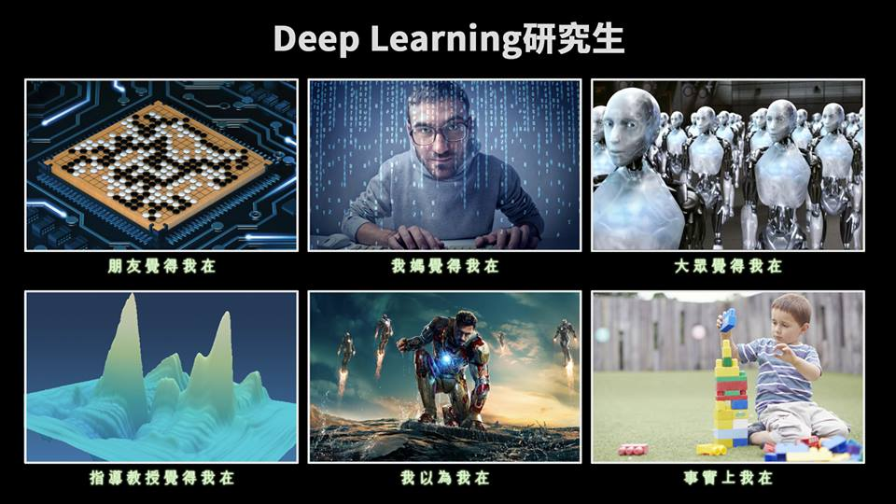
使用 Keras 心得
感謝 沈昇勳 同學提供圖檔

Slide 7
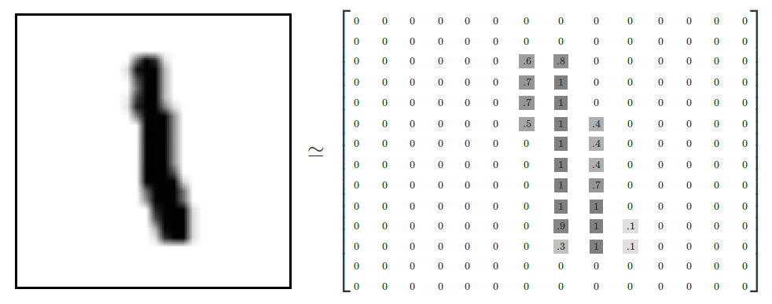
“Hello world”
Handwriting Digit Recognition
Machine
“1”
28 x 28
MNIST Data: http://yann.lecun.com/exdb/mnist/
Keras provides data sets loading function: http://keras.io/datasets/

Slide 8
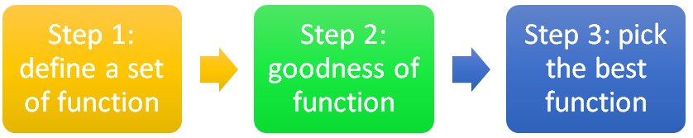



Keras
28x28
……
500
……
softplus, softsign, relu, tanh, hard_sigmoid, linear
500
……
Softmax
y₁
y₂
y₁₀
……
Notes:
https://en.wikipedia.org/wiki/Activation_function
Theno: Universite de Montr ´ eal
Yoshua Bengio

Slide 9
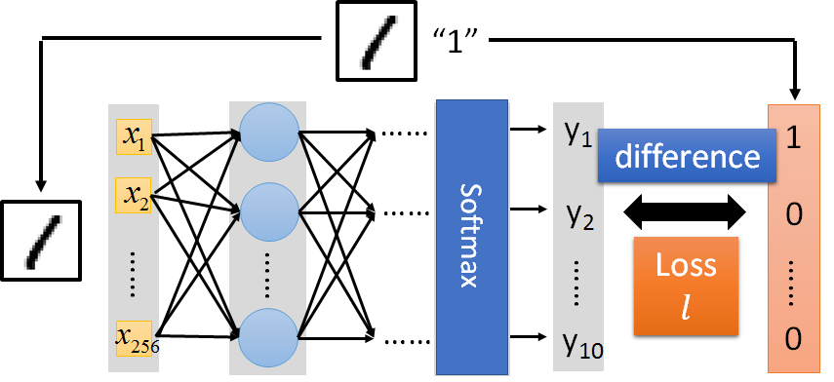

Keras
Several alternatives: https://keras.io/objectives/
Notes:
Theno: Universite de Montr ´ eal
Yoshua Bengio

Slide 10
Keras
Step 3.1: Configuration
SGD, RMSprop, Adagrad, Adadelta, Adam, Adamax, Nadam
Step 3.2: Find the optimal network parameters
Training data
(Images)
Labels
(digits)
In the following slides
Notes:
Theno: Universite de Montr ´ eal
Yoshua Bengio

Slide 11
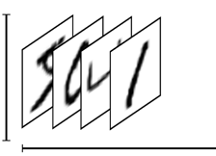
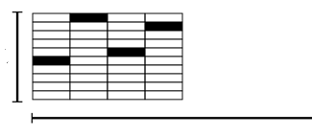
Keras
Step 3.2: Find the optimal network parameters
numpy array
numpy array
28 x 28
=784
……
10
……
Number of training examples
Number of training examples
https://www.tensorflow.org/versions/r0.8/tutorials/mnist/beginners/index.html
Notes:
Theno: Universite de Montr ´ eal
Yoshua Bengio

Slide 12
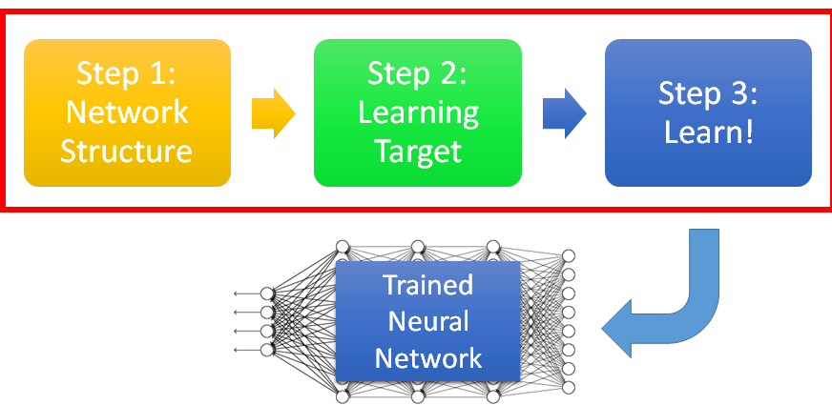


Keras
Save and load models
http://keras.io/getting-started/faq/#how-can-i-save-a-keras-model
How to use the neural network (testing):
case 1:
case 2:
Notes:
Scalar test loss (if the model has a single output and no metrics) or list of scalars (if the model has multiple outputs and/or metrics). The attributemodel.metrics_names will give you the display labels for the scalar outputs.

Slide 13
Demo

